Slide 1
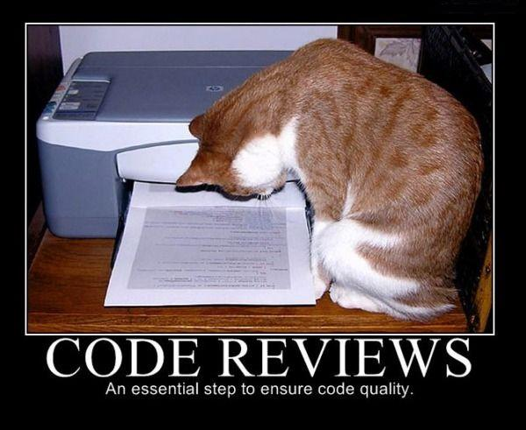
Quality Code
academy.zariba.com

Slide 2
Lecture Content
Software Quality
Code Formatting
Correct Naming
Documentation and Comments
Variables, Expressions and Constants
Control Statements – if, for, while, foreach…
High-quality Methods
High-quality Classes
Exceptions and Defensive Programming
Code optimization

Slide 3
1. Software Quality
External quality
Does the software behave correctly?
Are the produced results correct
Does the software run fast?
Is the software UI easy to use?
Is the code secure enough?
Internal quality
Is the code easy to read and understand?
Is the code well structured?
Is the code easy to modify?
Are there any repetitions?

Slide 4
1. Software Quality
High-quality programming code:
Easy to read, understand, modify and maintain
Behaves correctly – well tested
Well architectured and designed
Well documented (self-documenting code)
Well formatted
Strong cohesion and loose coupling at all levels
Good naming

Slide 5
2. Code Formatting
Put { and } on a line under the corresponding parent block
Indent the block contents by a single tab
Use empty lines for separation between methods
Brackets in the method declaration should be formatted without spaces
e.g. MethodName(int num)
e.g. MethodName ( int num )
The same applies to if conditions and for loops
Separate parameters by comma, followed by space
Use empty lines to separate logically related sequences of code
Always use { } brackets after if, for, while, foreach etc!
Break long lines after punctuation, or store complicated checks in a variable

Slide 6
3. Correct Naming
Always use English!
Avoid abbreviations (e.g. scrpCnt vs scriptsCount)
Use meaningful names. What the variable/class/ method is used for?
Meaningful names also depend on the context in which they are used e.g. Generate() in a class GetAllPaths. e.g. Generate() in the Program class
Don’t use “fake meaningful” names: e.g. Topic6Exercise12, LoopsExercise12, Problem7 etc.

Slide 7
3. Correct Naming
Use PascalCase for Methods, Classes, Structures, Properties, Enums, Namespaces etc.
Use camelCase for variables and fields
Name interfaces starting with “I” and add ”able” at the end where possible
If you are using your own exceptions, add “Exception” to the end of your class e.g. FileNotFoundException
The same Applies for Delegates or EventHandlers
Names can be as long as required – do not abbreviate and do not overcomplicate names.
Boolean variable names should imply true or false
Always use positive Boolean variable names, e.g.
if ( ! notFound )

Slide 8
3. Correct Naming
Use CAPITAL_LETTERS for const fields
Use PascalCase for readonly fields
Never give misleading names
Don’t use numbers in the names except when the number is part of the name.

Slide 9
4. Documentation and Comments
Documentation can be external:
At a higher level, compared to the code
Detailed with problem definition, requirements, architecture, design, project plans, test plans, sound, gameplay, modes, graphics etc.
Or internal:
At a lower level – explains a class, method or piece of code

Slide 10
4. Documentation and Comments
Do not comment every single line in your code – most lines of code (if well-written) are obvious and do not need further explanation
Effective comments do not repeat the code
If you are writing quality code it will not need to be commented – self-documenting
To write self-documenting code you should make it self-explainable, easy to read and write
Do not explain bad code – rewrite it!
Focus comments on why? rather than how?
Comment on workarounds, hacks, bugs, TODO
Write summaries in C#

Slide 11
4. Self-Documenting Code checklist
Does the interface present a consistent abstraction?
Does the interface make it obvious how you should use the class?
Is the class well-named? Does the name describe the purpose?
Do you reuse code in your class hierarchy?
Does each each routine’s name describe exactly what the method does?
Does each method perform one well-defined task?
Are type names descriptive enough?
Are variables used only for a single purpose related to their name?
Does naming conventions distinguish among types?

Slide 12
5. Variables, Expressions and Constants
Initialize all variables right before their first usage!
Pay special attentions to counters, sums, products etc.
Check whether the data is in the correct format for your purpose
Don’t define unused variables
ALWAYS assign the result of a method in some variable before returning it
Think about the “visibility” of your variables – public, protected, internal, private … Always try to maximally reduce visibility
Always initialize variables, right before they are used
Do not declare variables on the same line
Variables should have a single purpose
If you cannot choose a good name for your variable, think of 9.
Avoid complex expressions – separate indexes and Boolean checks in variables
Do not use magic numbers – use constants

Slide 13
6. Control statements
Always use { and } for control statements, even if the body is on a single line!
Always put the normal ( expected ) conditions first
Avoid comparing to true or false e.g. (HasErrors() == true)
Always consider the else case
Avoid double negation e.g. (!HasNoError)
Do not copy paste code in if-else statements
Do not use complicated if conditions – simplify in variables or methods
Use brackets to improve readability and maintainability of complicated conditions
Avoid deep nesting of statements – more than 3 is too deep

Slide 14
6. Control statements
Use for loop to repeat some block of code a certain number of times
Use foreach loop to process each element of a collection
Use while/do-while when you do not know how many times a block should be repeated
Keep loops simple
Avoid empty loops
Don’t change the value of a for loop to stop the loop – use while instead
Avoid break/continue if you can. Use while + condition instead
Do not EVER use “go-to”

Slide 15
7. High-quality Methods
Using methods reduces complexity, improves readability, helps avoiding repetition
Methods hide implementation details and increase the level of abstraction
Methods should consider all possible scenarios of the given task they perform
Methods should have strong cohesion and loose coupling
Do not modify method parameters. Create new variables if needed
Limit the number of parameters to 7 (+/- 2)
Put the most important parameters first

Slide 16
8. High-quality Classes
Strong cohesion, loose coupling
Use inheritance to reuse repeating code – data and logic, and to simplify maintenance
Polymorphism is a tool to enable code reuse – implemented via virtual, abstract or interfaces
Present a consistent level of abstraction
Minimize visibility of classes and members – encapsulation
Use design patterns (next lecture)
Use namespaces to structure your application design and architecture
Never use plural noun as a class name unless they hold some kind of collection – e.g. public class Teachers , e.g. public class GameFieldConstants
Do not throw exceptions without parameters
Always use this to access members within the class!

Slide 17
8. High-quality Classes
Don’t use magic numbers
Call the base constructor to reuse code
Do not copy-paste code – properties, methods or fields. This is always a bad practice
The base class should never know about its children
Do not break encapsulation
Move repeating code upper in the hierarchy
Extract abstract classes from classes

Slide 18
9. Exceptions and Defensive Programming
Similar to defensive driving, you are never sure what other drivers will do
The same applies to programming – expect incorrect input and handle it correctly
Consider unusual situations, parameters etc.
Protect from invalid input
Decide how to handle bad inputs – return neutral value, substitute with valid data, throw an exception, display error message etc.
Use try-catch to handle exceptions
Use finally block to always execute needed code if exception occurs
Use descriptive error messages
Always try to keep the software running

Slide 19
10. Code Optimization
Remember! “Premature optimization is the root of all evil” Donald Knuth
Often the code quality is decreased to increase the performance
Code Tuning Myths
“Reducing the lines of code improves the speed”
“A fast program is just as important as a correct one”
“Certain mathematical operations are faster than others” e.g. * and +, or multiplying and bitwise operations
“You should optimize as you go”
Junior developers think that selection sort is slow. Is this correct?

Slide 20
10. Systematic Tuning Steps
Assess the problem and establish numeric values that categorize acceptable behavior
Measure the performance before modification
Identify the part of the system that is critical for improving the performance (this is called a bottleneck)
Modify the part of the system to remove the bottleneck
Measure the performance of the system after modification
If the modification makes the performance better, use it
If not, remove it
Rinse and repeat

Slide 21
10. Optimization Tips
C# is fast (unlike Java). It is a bit slower than C and C++.
Tips:
Static fields and methods are faster than instance fields
It is faster to minimize method arguments
Constants are fast
Some switches are faster than if statements
Using two-dimensional arrays is relatively slow
StringBuilder can considerably improve performance. Char[ ] is the fastest way to build a string, but has limitations
Simple array T[ ] is always faster than List<T>
Use efficient data structures e.g. HashSet, Dictionary
For loops are faster than foreach loops
Structs are faster than classes
It is better to work with a char instead of a single-char string

Slide 22

References

Slide 23



Zariba Academy
Questions

